Slide 1
A Distributed System Case Study: Apache Kafka
High throughput messaging for diverse consumers

Slide 2
As always, this is not a tutorial
Some of the concepts may no longer be part of the current system or implemented as described.

Slide 3
LinkedIn’s Requirements
LinkedIn needs to push billions of messages per day to a wide variety of consumers
Real-time processing applied to activity streams
Keep people engaged with the site through social network-supplied content.
Asynchronous processing
Find people I may want to connect to
Find topics that may be interesting to me
Identify advertisements that I may be interested in
System logs: Identify problems with operations
Machine learning is critical to all of these. But is OK to lose some data.

Slide 4
Consequences of Use Case Requirements
Consumers must decide when to pull the data
Fast or slow, small or large
This means that the messaging system needs to store a lot of data (TBs)
This is not what traditional message systems are designed to do.
Kafka will need an efficient way to find the requested message
Virtue from Necessity: support message rewind and replay
This is not a normal operation for a queue, which removes messages after they are delivered.
Treat the accumulated, ordered messages as input for a state machine

Slide 5
Apache Kafka and Related Work
Apache Kafka is a hybrid of a log aggregator and a messaging system
Messaging systems
Usually assume low latency of delivery. Messages are delivered quickly
This doesn’t work for batch systems
Have complicated delivery guarantees that aren’t needed for real-time data
Are not designed for high throughput techniques such as message batching
Weakly designed as distributed systems: consistency rather than availability (CAP)
Distributed Log Aggregators (Scribe, Flume, Hedwig)
Are only for server logs
Only support push model: producer sets the rate
Kafka use case: pull model lets consumers set the rate, support rewind

Slide 6
Kafka supports many different types of consumers
https://image.slidesharecdn.com/current-141113081750-conversion-gate02/95/current-and-future-of-apache-kafka-9-638.jpg?cb=1415866728

Slide 7
Apache Kafka Terminology: Topic-Based Publish-Subscribe
Component | Description
Topic | The label for a stream of messages of a particular type.
Producer | An entity that publishes to a topic by sending messages to a broker
Broker | An entity on a network that receives, stores, and routes messages.
Consumer | An entity that subscribes to one or more topics. Kafka generalizes this to Consumer Groups

Slide 8
Kafka Brokers
Connecting message producers to consumers

Slide 9
Kafka Uses Clusters of Brokers
Kafka is run as a cluster of brokers on one or more servers.
Note use of Zookeeper. Zookeeper also used by Producers and Consumers

Slide 10
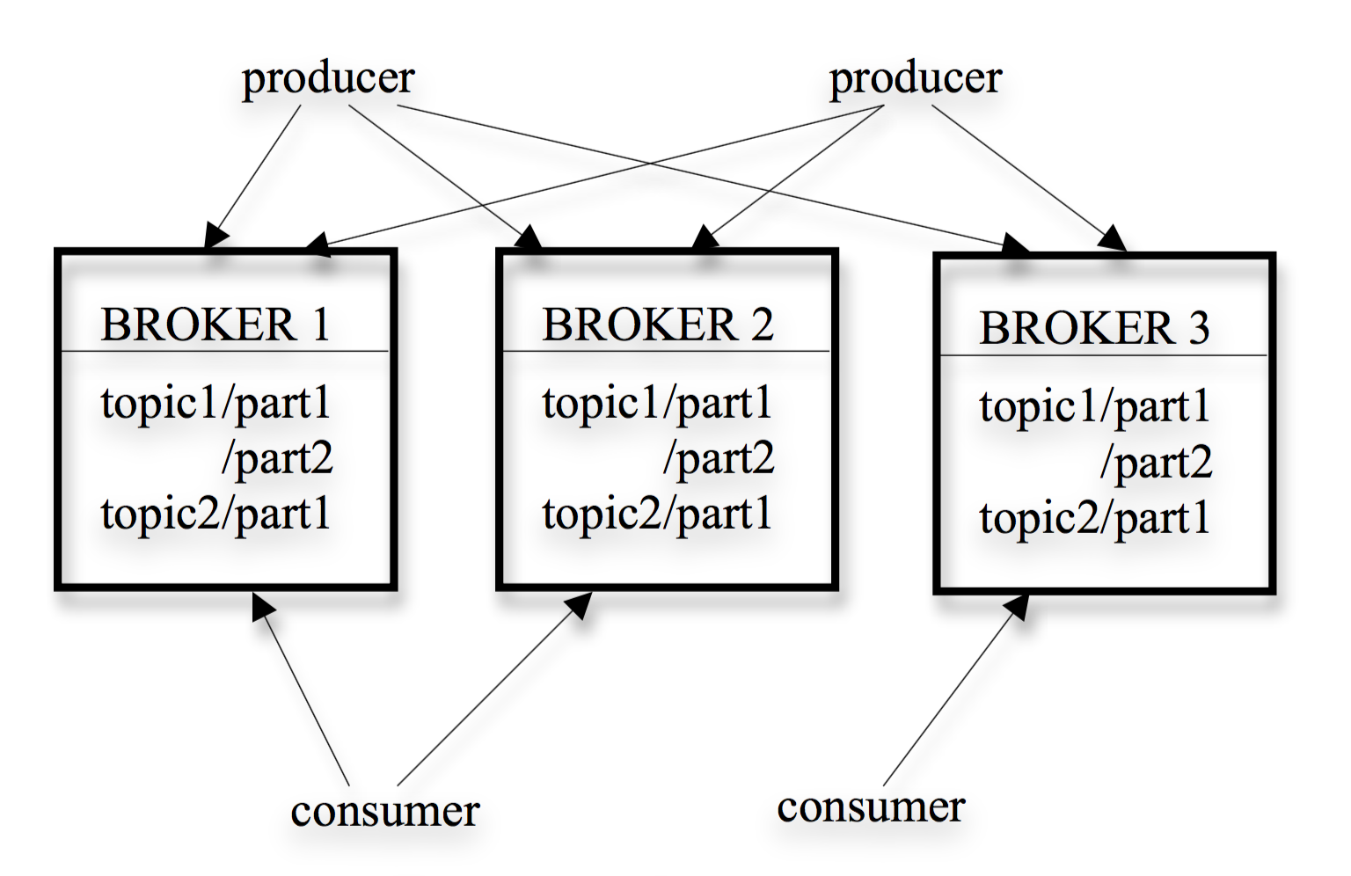
Distributed Brokers
Kafka brokers are designed to be distributed
Multiple brokers
Messages to each topic are stored in partitions
Partitions are allocated across brokers
Partitions are stored as multiple segment files on a specific broker.

Slide 11
Topics and Partitions
Topics are broken up into partitions that span multiple brokers

Slide 12
Kafka Partitions
Kafka topics are divided into partitions.
Partitions parallelize topics by splitting the data across multiple brokers
Each partition can be placed on a separate machine
Allows multiple consumers to read from a topic in parallel.
Topic content size can be larger than physical storage on any one broker
Consumers can also be parallelized to read from multiple partitions
Kafka guarantees all messages in a partition are time-ordered, but it does not guarantee order across partitions. Choose partitioning strategies accordingly.

Slide 13
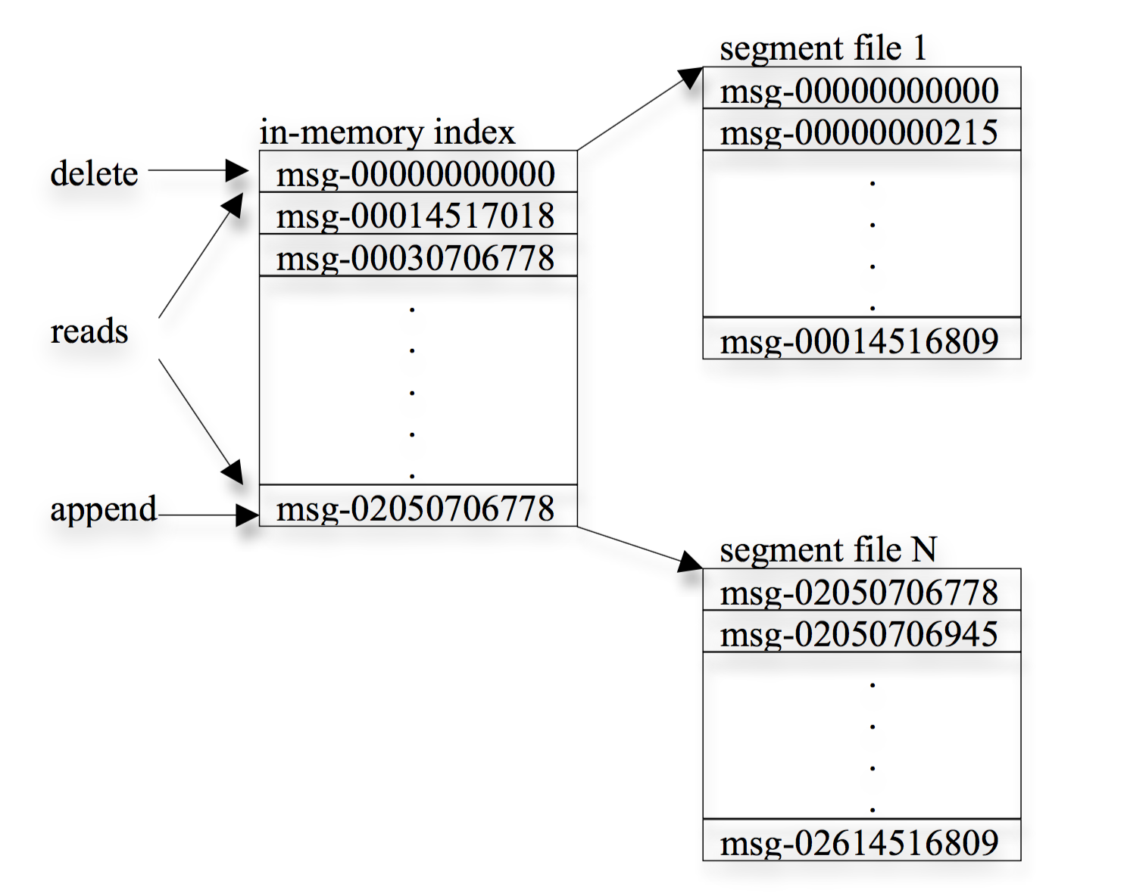
Sequential, Deterministic Lookups
Random access is anathema to Kafka’s goals for high throughput.
Partitions consist of one or more segment files
Each message stored in a segment file has a local ID that is determined by the size of all the messages that come before.
An index stores the message ID of the first message in a segment

Slide 14
Aside: Write-Ahead Logging
Write-Ahead Logging: this is a technique of writing your file first and then having your broker read the file.
This is the reverse of the way logging normally works
Why? If the broker needs to be restarted, it reads it log to recover its state.
You don’t need to worry so much about lost messages from publishers.
Kafka uses the file system
Linux file systems already have many sophisticated features for balancing in-memory versus on-disk files

Slide 15
Kafka Partitions Are Replicated
If a leader for a partition replica fails, a follower becomes the new leader

Slide 16
Producers

Slide 17
Kafka Producers
Producers publish data to the topics of their choice.
The producer is responsible for choosing which record to assign to which partition within the topic.
This can be done in a round-robin fashion simply to balance load
Other distribution strategies can be used.
Producers write to the partition’s leader.
The broker acting as lead for that partition replicates it to other brokers

Slide 18
A producer writes to Partition 1 of a topic. Broker 2 is the leader. It writes replicas to Brokers 1 and 3

Slide 19
Consumer Groups

Slide 20
Kafka Consumer Groups
Consumer groups contain one or more consumers of a particular topic.
Many consumer groups can subscribe to the same topic.
A consumer group is whatever is useful for a particular consuming application
Only one member of a consumer group consumes the messages in a partition
Avoid locking and other state management issues
Kafka wants to divide messages stored on brokers evenly among consumers for load balancing
But keep it simple, avoid complicated coordination.

Slide 21
Consumers and Consumer Groups
Kafka lets you collect consumers into consumer groups
In a group, each consumer instance is associated with a specific partition.
Collectively, a group receives all messages on a topic.
If the group expands or contracts, Kafka will rebalance.
Consumer groups resemble queues

Slide 22
Consumer Group Scenarios
Consumer Load Balancing: All consumers are in one group
Consumer Group B, previous slide
Broadcast: each consumer is its own group
Each consumer receives messages from all partitions
Broker Load Balancing: N(Brokers) > N(Consumer Groups)
Consumer Group A, previous slide
But messages between partitions may not be ordered
Consumer ordering: N(Partitions) == N(Consumers in a Group)
Each member gets messages from only one partition
We assume round-robin message distribution to partitions. Note message order is preserved only within a partition

Slide 23
Rewinding and Replaying Messages
Kafka persistently stores messages much longer than conventional messaging systems
Doesn’t assume low-latency delivery.
The state of a topic is the message order, stored in partition files.
A consumer can request the same messages many times if it needs to.
Why? Rollback. A consumer may have had a bug, so fix the bug and consume the message again with the corrected code.
Recall Blue-Green deployments
Or the consumer may have crashed before processing the message
This is NOT a typical queue pattern.
Rewinding is much more straightforward in a pull-based architecture.

Slide 24
Kafka and Zookeeper
Managing brokers, consumers, and producers

Slide 26
Zookeeper Registry | Description | Node Type
Broker Registry | Contains brokers’ host names, ports, topics, and partitions. Used by the brokers to coordinate themselves. Ex: deal with a broker failure. | EPHEMERAL
Consumer Registry | Contains the consumer groups and their constituent consumers. | EPHEMERAL
Ownership Registry | Contains the ID of the consumer of a particular consumer group that is reading all the messages. This is the “owner”. | EPHEMERAL
Offset Registry | Stores the last consumed message in a partition for a particular consumer group. | PERSISTENT
Each consumer places a watch on the broker registry and the consumer registry and will be notified if anything changes.

Slide 27
Delivery Guarantees
Kafka chooses “at least once” delivery.
It is up to the consuming application to know what to do with duplicates
Duplicates are rare, occur when an “owning” consumer crashes and is replaced
Two-phase commits are the classic way to ensure “exactly once” delivery.
Messages from a specific partition are guaranteed to come in order.
Kafka stores a CRC (a hash) for each message in the log to check for I/O errors

Slide 28
What About the Message Payload?
Apache Kafka supports clients in multiple programming languages.
This means that the message must be serialized in a programming language-neutral format.
You can make your own with JSON or XML
Kafka also supports Apache Avro, which is a schema-based binary serialization format.
Compare Avro with Apache Thrift and Protobuf
Efficient message formats are essential for high throughput systems

Slide 29
Kafka, Airavata, and Microservices
Some thought exercises

Slide 30
Three microservices, replicated
API Server
Application Manager
Metadata Server
API Server
API Server
API Server
API Server
Application Manager
Metadata Server
Application Manager
Metadata Server
Application Manager
Metadata Server
Application Manager
Metadata Server
Application Manager
Metadata Server
Application Manager
Metadata Server

Slide 31
Messaging and Microservices
In Assignment 2, we that message queues are a good way to deliver messages to service replicas.
Each replica of a service gets a message
Topics are a good way to associate message types with different service groupings.
Application manager and metadata manager
In Kafka, we could put each of these into a consumer group
However, work queues are very important to Airavata
This is not directly implemented in Kafka, so we would need to implement
This is probably not a good strategy.
We could always just use Kafka as a log aggregator.

Slide 32
Some General Distributed Systems Principals
Kafka, logs, and REST

Slide 33
Log-Centric Architecture
Distributed servers use a replicated log to maintain a consistent state
The log records system states as sequential messages.
New servers can be added to expand the system or replace malfunctioning servers by reading the log
No in-memory state needs to be preserved
The server just needs to know that it has an uncorrupted (not necessarily latest) version of the log.
You can use this approach for both highly consistent and highly available systems (CAP)
Kafka is a log-oriented system that can be used to build other log-oriented systems

Slide 34
This just leaves one little problem...
How do you keep the log replicas up to date?

Slide 35
Primary-Backup Replication | Quorum-Based Replication
1 leader has the master copy and followers have backups | 1 leader has the master copy and followers have backups
On WRITE, the master awaits the appending to all backup for acknowledging the client | On WRITE, the master waits on only a majority of the followers to confirm backups before it returns
Supports strong consistency for distributed READS, but doesn’t scale easily and has lower throughput | Supports eventual consistency and higher throughput; doesn’t require good networking between leader and followers
If the master is lost, restore from a backup | If a master is lost, elect a new leader from the replicas that have the latest data
F+1 replicas can tolerate F failures | 2F+1 replicas can tolerate F failures

Slide 36
Kafka State Management
Kafka brokers are stateless
They don’t track which messages a client has consumed or not.
This is the client’s job
Brokers simply send whatever the client requests
Compare to REST
Brokers eventually must delete data
How does a broker know if all consumers have retrieved data?
It doesn’t. Kafka has a Service Level Agreement:
“Delete all data older than N days” for example

Slide 37
Kafka | Traditional Messaging: AMQP, JMS, Etc
Brokers are stateless. This makes broker distribution simpler. State management is done by producers and consumers. | Brokers are state-full. This makes distribution more difficult since load balancing and fault recovery are harder.
Messages can be delivered in batches | Messages are individually delivered
”At least once” delivery | “Exactly once” delivery
Eventual consistency model for messages partitioned across one broker | Strong consistency between brokers in a distributed system
Optimized for highly variable latency, large message throughput: streaming data, logs to late night batch pulls | Optimized for low latency delivery of smaller messages
Assumes replay of messages | Replay is an add-on
Apache Kafka resembles in some ways the REST architecture

Slide 38
Sources
Kreps, J., Narkhede, N. and Rao, J., 2011, June. Kafka: A distributed messaging system for log processing. In Proceedings of the NetDB (pp. 1-7).
Wang, G., Koshy, J., Subramanian, S., Paramasivam, K., Zadeh, M., Narkhede, N., Rao, J., Kreps, J. and Stein, J., 2015. Building a replicated logging system with Apache Kafka. Proceedings of the VLDB Endowment, 8(12), pp.1654-1655.
https://kafka.apache.org/documentation/
https://sookocheff.com/post/kafka/kafka-in-a-nutshell/

Slide 40
Log Processing and Distributed Messaging
Companies like LinkedIn have both real-time and batch processing needs
Batch processing: traditional business analytics
Done on Hadoop hourly or daily
Too slow to capture social network data: likes, views, updates to news feeds, etc
Real-time processing needs to live side by side with batch processing
They built a system that could do both: Apache Kafka

